Slide 1
Programming for graphics
Textures

Slide 2
What are textures?

Slide 3


bitmap
(Computer imagery terms):
A rectangular collection of pixel data, arranged to store an image.
Raster image.

Slide 4
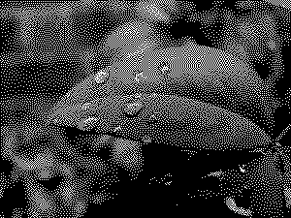
What is a bitmap?
Origin of term originally meant a collection of ones and zeros arranged in a 2D array.
e.g. a binary image:

Slide 5
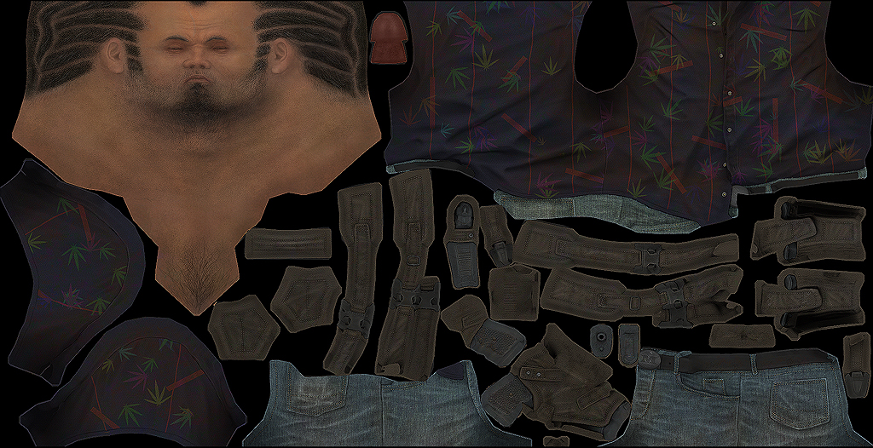
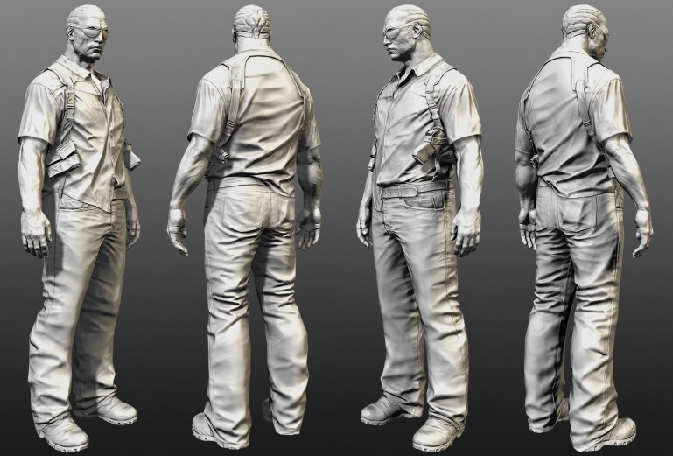
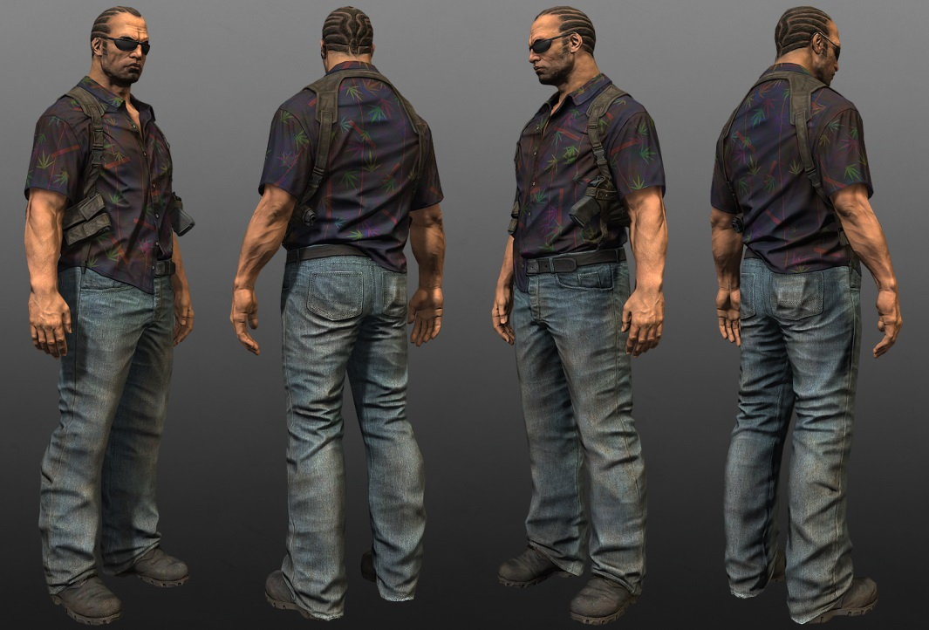
Complicated Bitmaps
Street Cop Workflow – Mashru Mishu
http://en.9jcg.com/comm_pages/blog_content-art-180.htm

Slide 6
What we can use textures for?

Slide 7
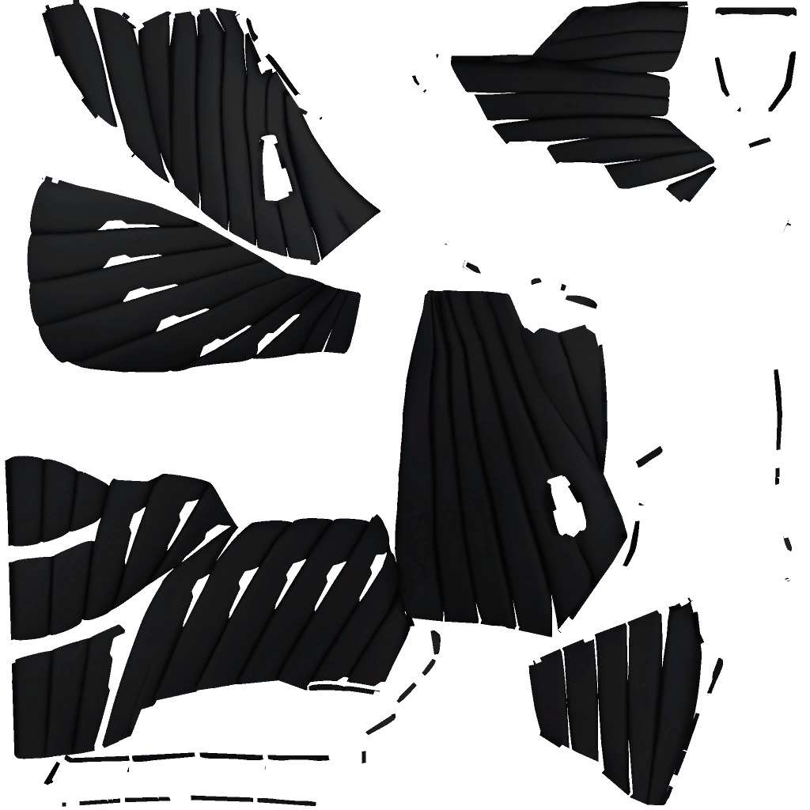
Diffuse maps
Add colour to our mesh

Slide 8
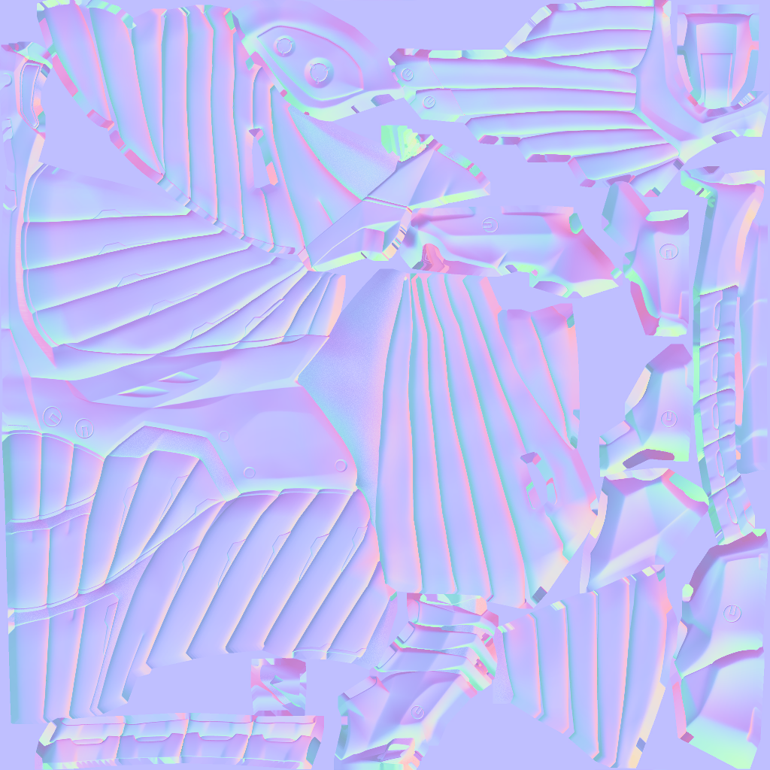
Normal maps
Offsets the normal of the surface, giving the illusion of more detail.
(more on this in coming weeks)

Slide 9
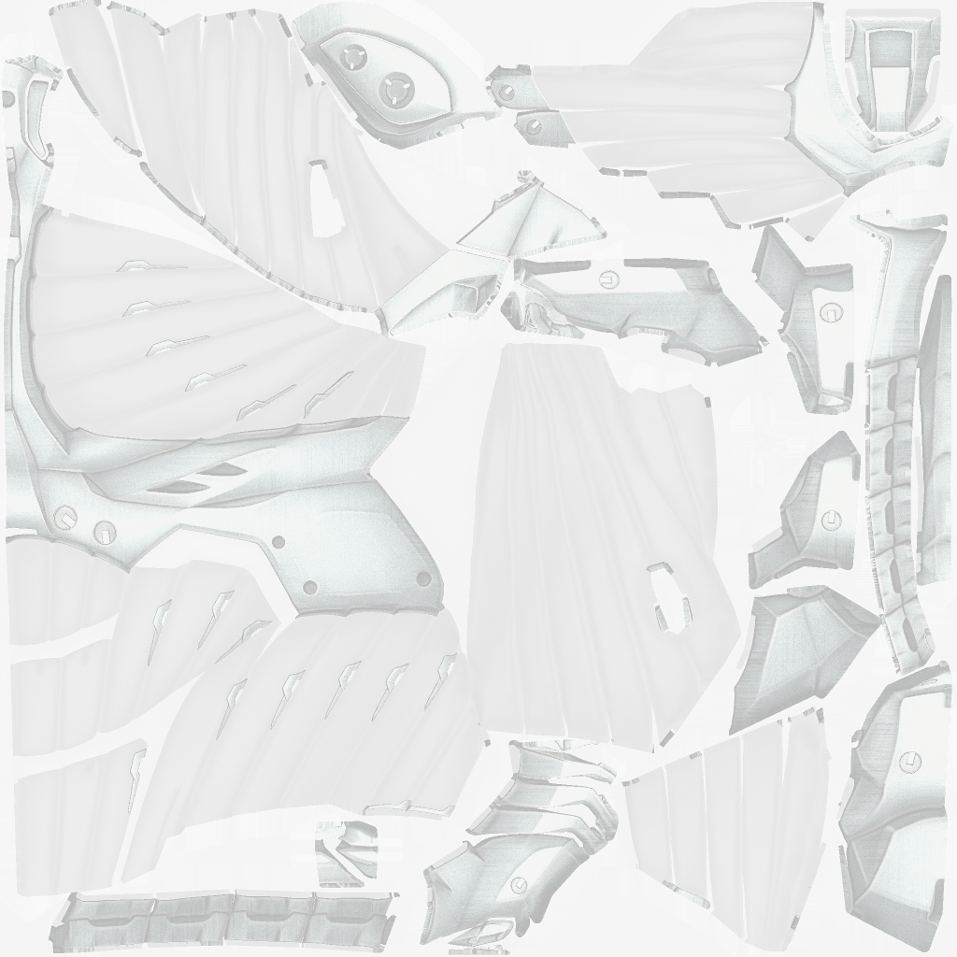
Specular maps
Masks which fragments should have a specular gloss to them and how much.
IE it controls shininess.

Slide 10
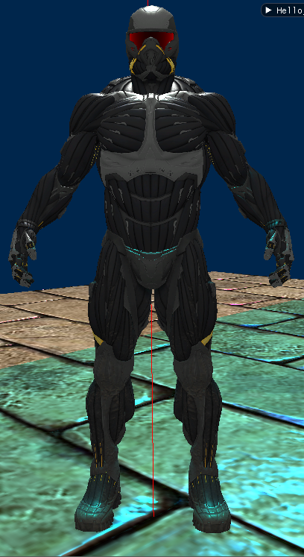
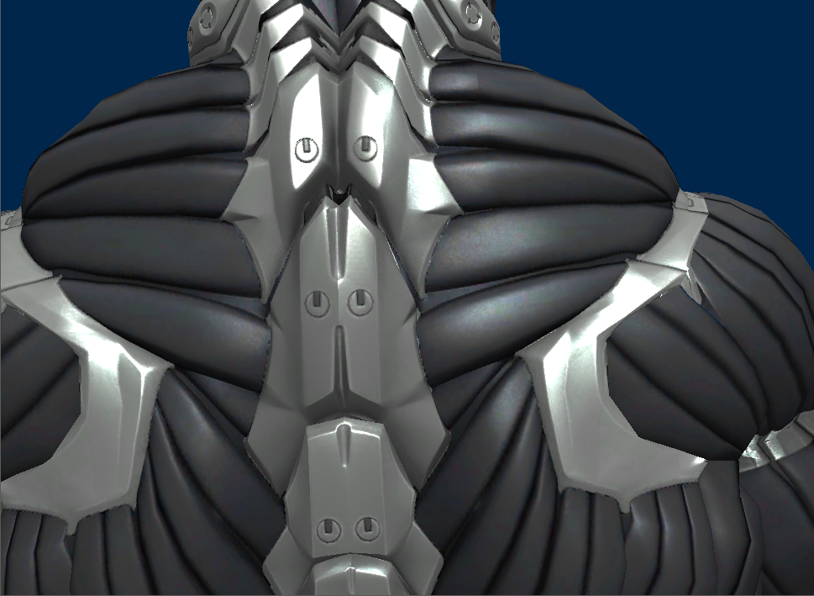
result

Slide 11
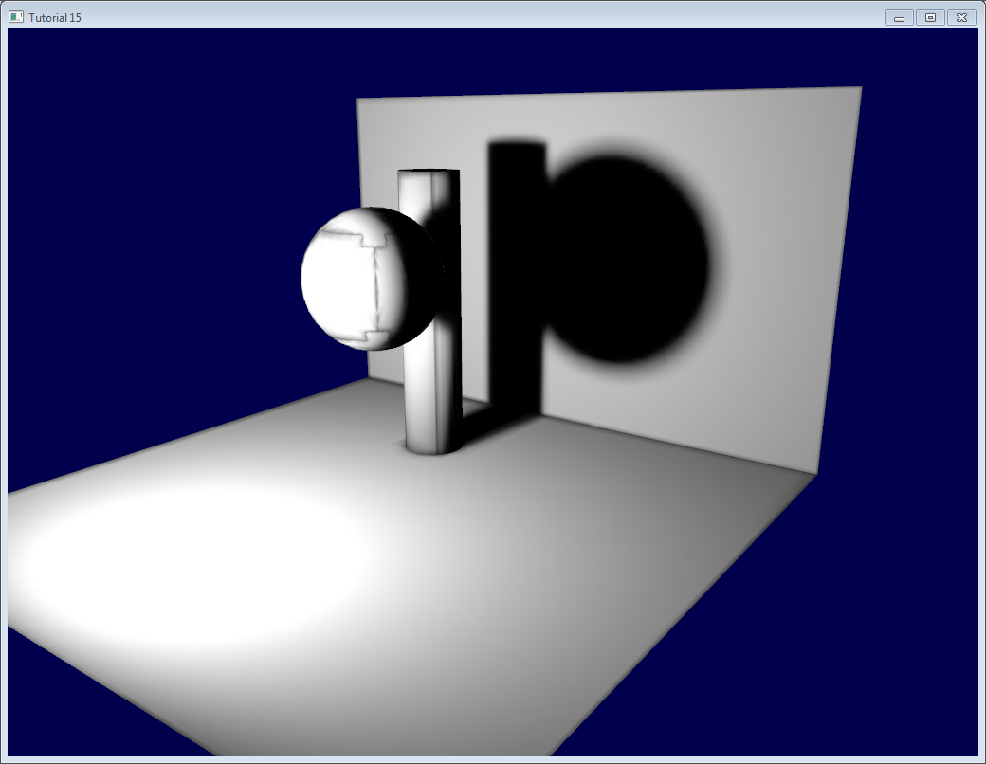
Shadow maps
A texture that holds bakes (pre-computed) shadow colours.

Slide 12
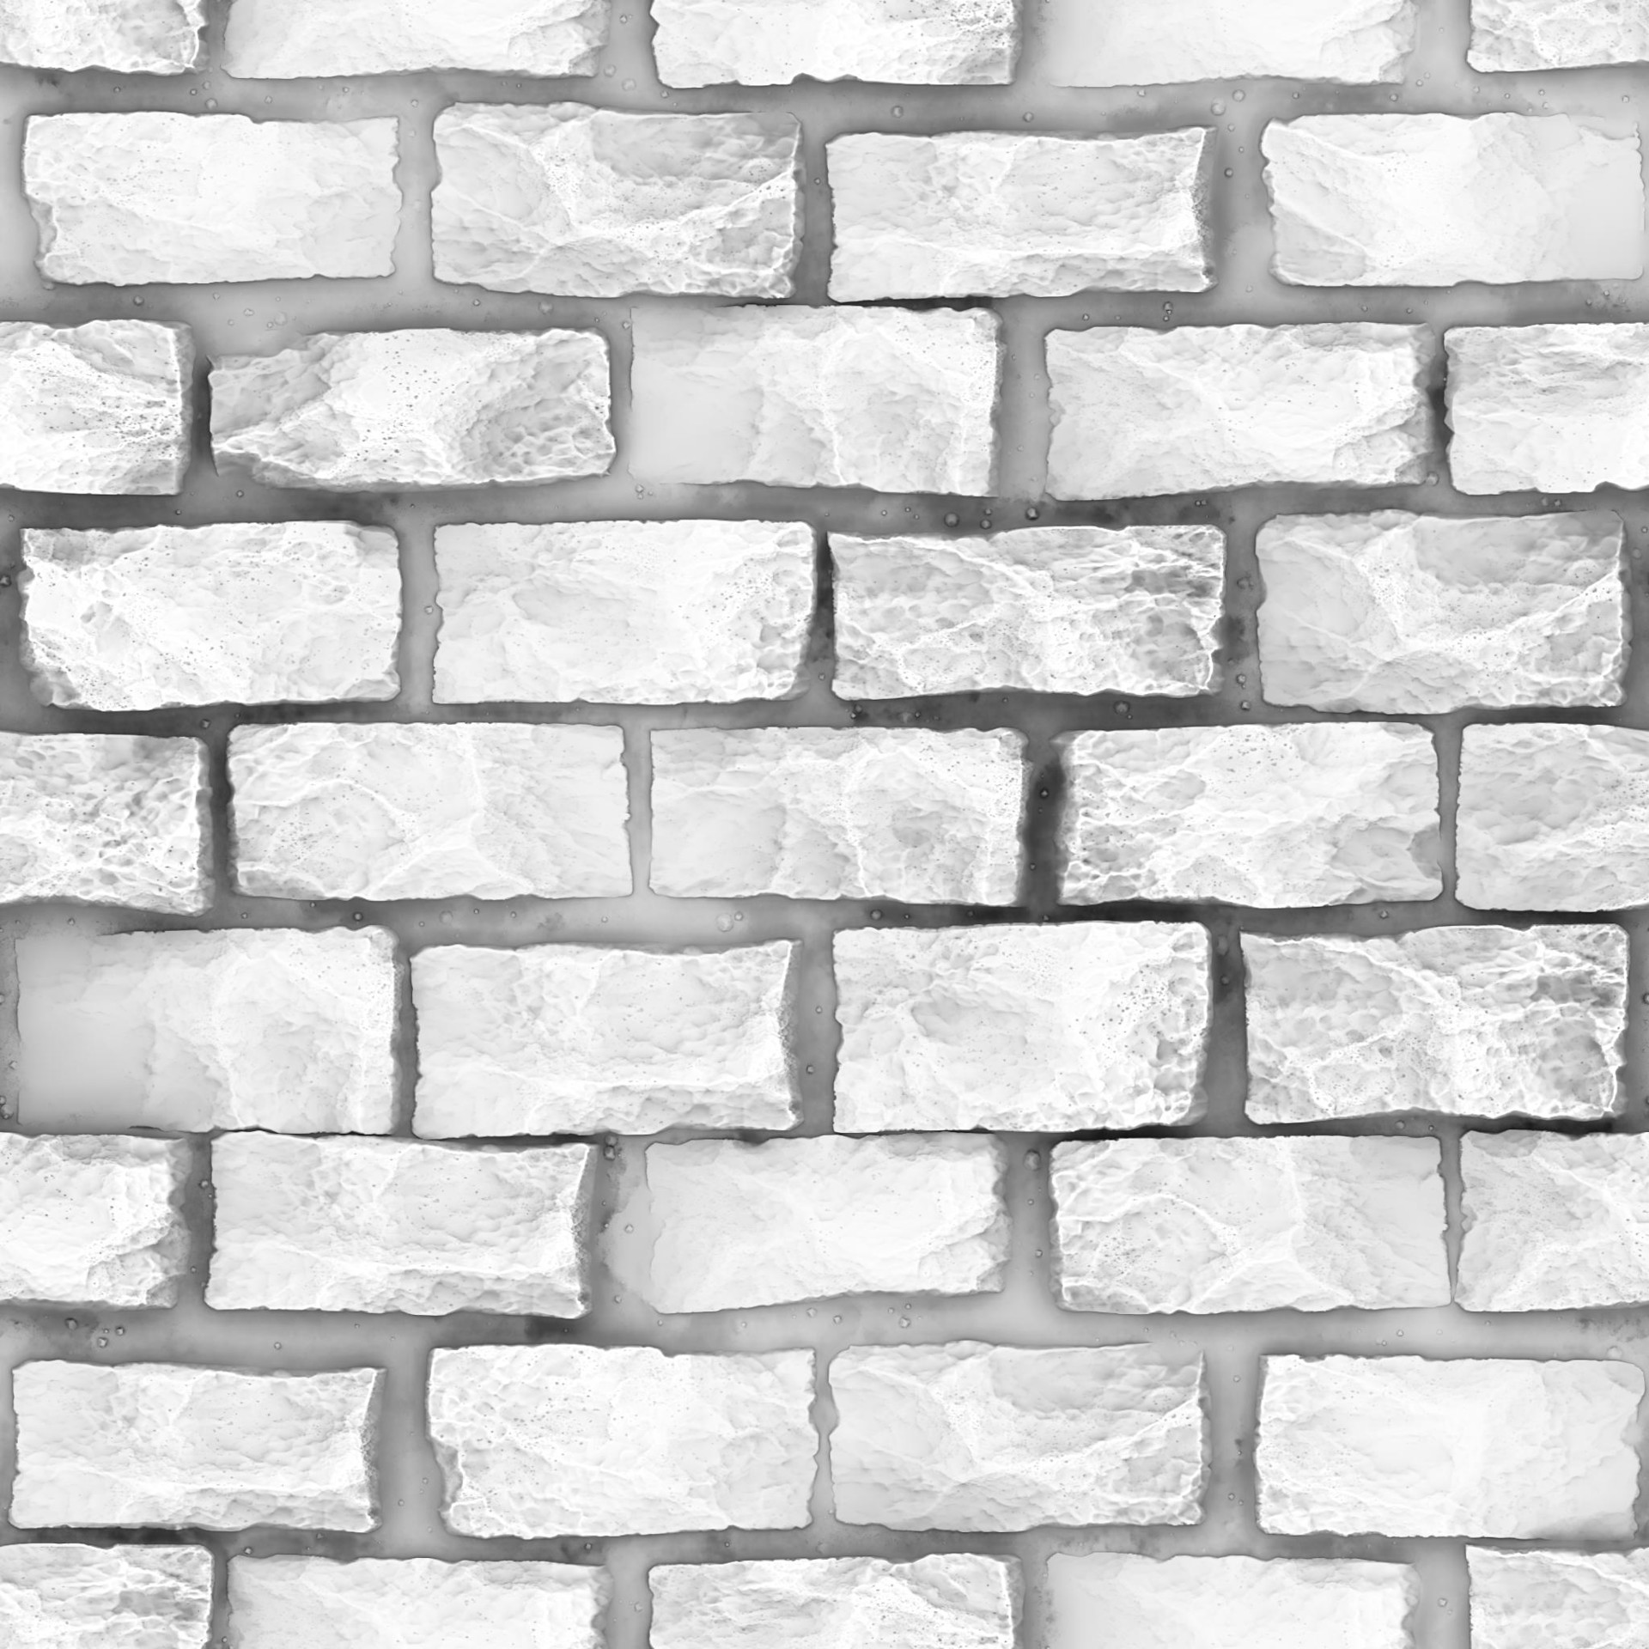
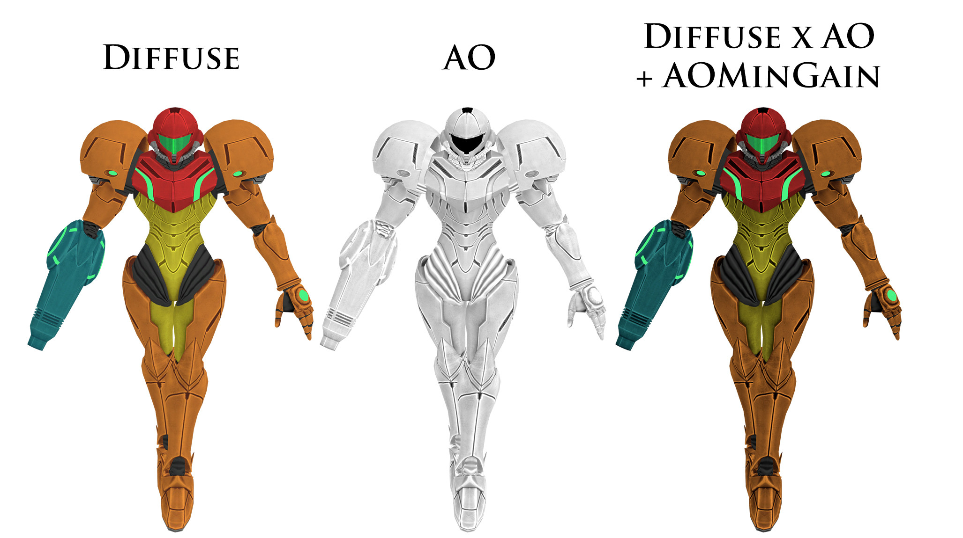
Occlusion Maps
Add darker areas to a mesh, where geometers is partly occluded by other geometers (joins, corners, etc) and thus is harder for light to get to.

Slide 13
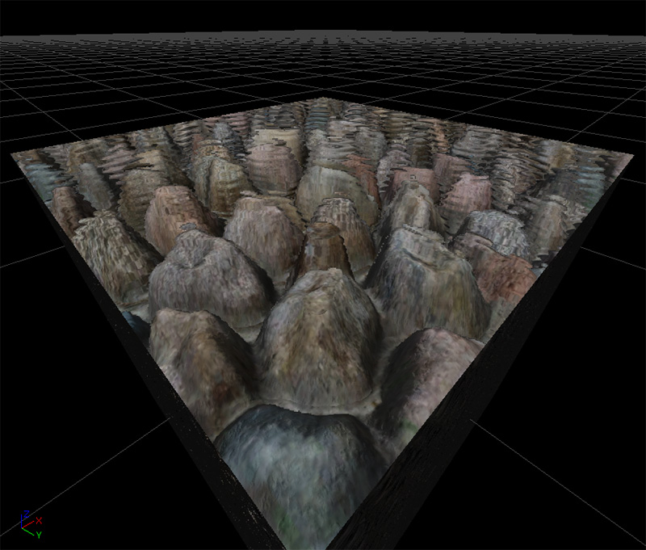
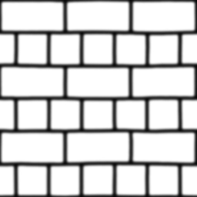
Paralax Maps
Used to fake depth.
Like normal mapping but … not…

Slide 14
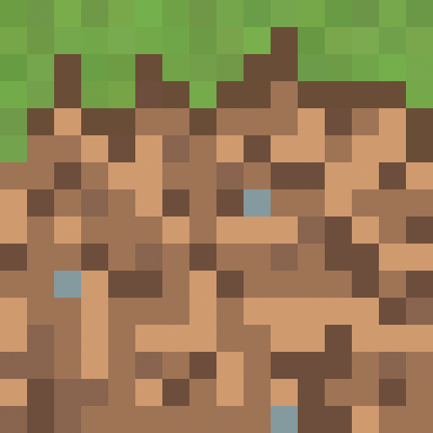
Texels
Texture Elements
Refers to the pixels in the texture

Slide 15
How Textures are applied

Slide 16
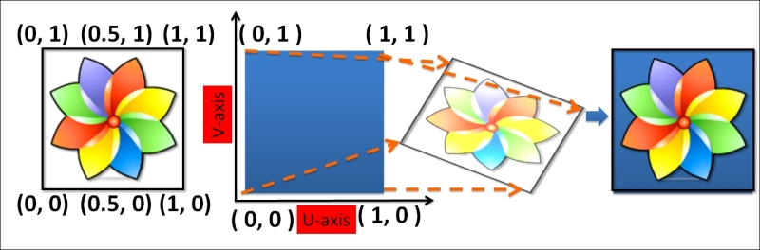
Texture Coordinates or UV’s
Textures are mapped to a quadrilateral, this allows us to easily map between pixel H/W and an arbitrary H/W between 0 and 1.
We are not looking for exact pixels at a location, we want the approximate colour.
This might be a combination of neighboring pixels as well as the one we want.
This also help reduce texture aliasing.

Slide 17
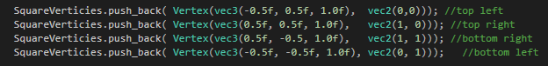
UV’s and vertex positions
Our UV’s will be pushed to the GPU with vertex positions.
This effectively tells the GPU that a given vertex has a specific texture map coordinate and that it needs to be interpolated across all fragments in the connected triangle.
So each fragment will end up with a UV between the values specifies in the verts that make up a triangle.

Slide 18
Textures in opengl
Textures have to be created on the GPU and than filled from a bitmap file.

Slide 19

TMU (Texture Mapping Unit or Texture unit)
Hardware deigned to preform transformations on 2D textures (scale, rotate) and texture sampling.
I couldn’t find an image to show you this
So have a Lego batman!

Slide 20
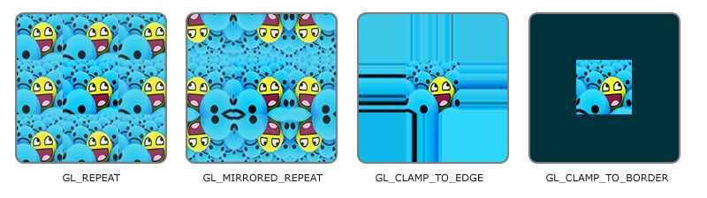
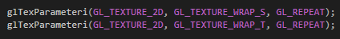
Texture wrapping
UV values can be larger then 1 and less than 0.
What do we do if we get a value outside our expected range?
There are several things we can do.
GL_REPEAT
GL_MIRRORED_REPEAT
GL_CLAMP_TO_EDGE
GL_CLAMP_TO_BORDER
We are going to use repeat
Why the S and the T?

Slide 21
ST and UV
Strictly speaking, ST are our texture coordinates associated with our vertex
And UV are the values associated with the texture patch we have loaded in to memory
Most of the time, they end up being the same value and doing the same kind of thing.
So we use UV as a synonym for ST.

Slide 22

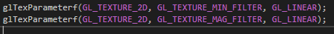
Texture filtering
Tells openGL how we want to interpolate our image
Nearest takes the nearest texel (Manhattan distance) and copes it.
Sharper look but with patchy effects
Linear returns the weighted average of the four texels that are closest to the centre of the pixel being textured
Notice that we use Min and Mag as our filtering options

Slide 23
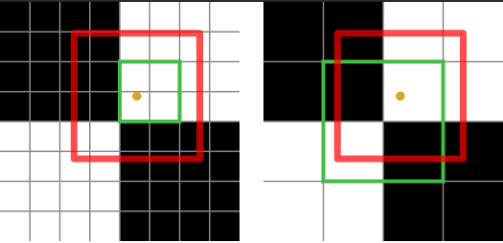
Filtering Cont
What do we do when our fragment is bigger than a texel?
What do we do when it smaller or off centre?

Slide 24
Minification
Neartes
Take the texel under the fragment, ignore all others
Fragment bigger than one texel?
Minify the texels the fragment covers
Linear
Take the weighted average of the nearest texels

Slide 25
Magnification
Neartes
Take the texel under the fragment, ignore all others
Fragment smaller than one texel or not centred on the texel?
Linear
Take the weighted average of the nearest texels
In both cases, we need to tell openGL what to do.

Slide 26
Mipmaps

Slide 27
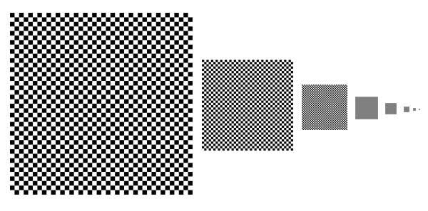
What are they?
Precalculated, scaled versions of an original image.
Fragments that a close to the camera can sample a texture accurately. As the mesh extends in to the distance, the texture becomes distorted.

Slide 28
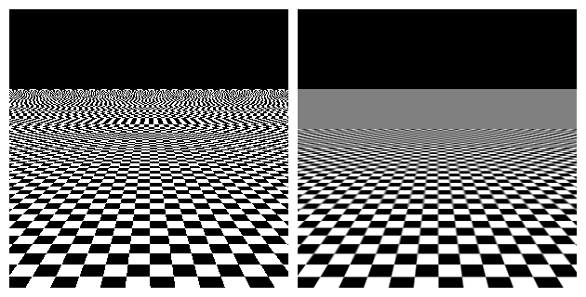
Like this!
MY EYES!

Slide 29
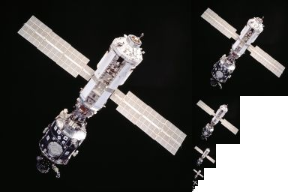
Generating mipmaps
This is your home work.

Slide 30
The result
That slightly better
Before
After

Slide 31
Questions?

